Slide 1

Mobile Image Scanner
ENEE631
Ananya Mukherjee

Slide 2
Introduction
Developed an algorithm to scan document images captured by a mobile camera. There are 4 parts in this implementation:
Basic Scanning
Partial form scanning and stitching
Reading filled forms
OCR

Slide 3
Basic Scanning: Implementation Pipeline

Slide 4
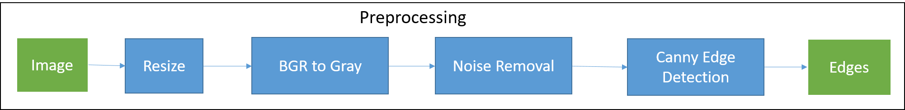
Preprocessing

Slide 5
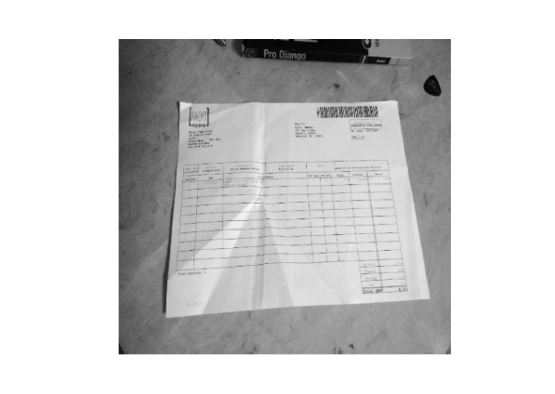

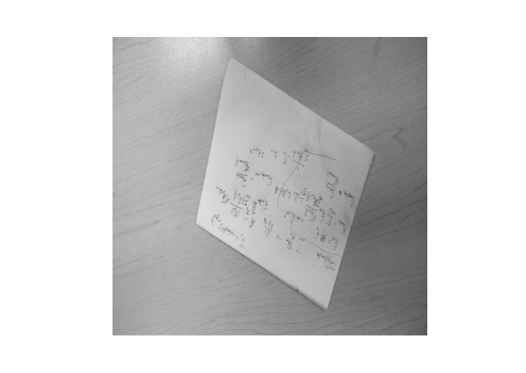
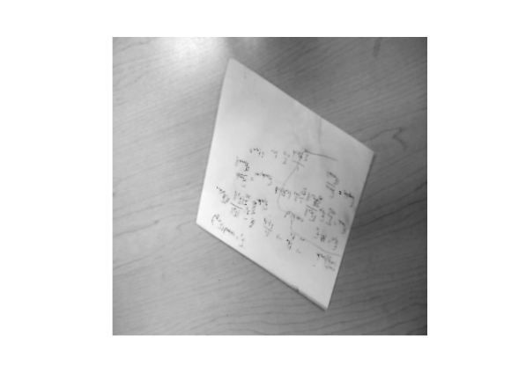
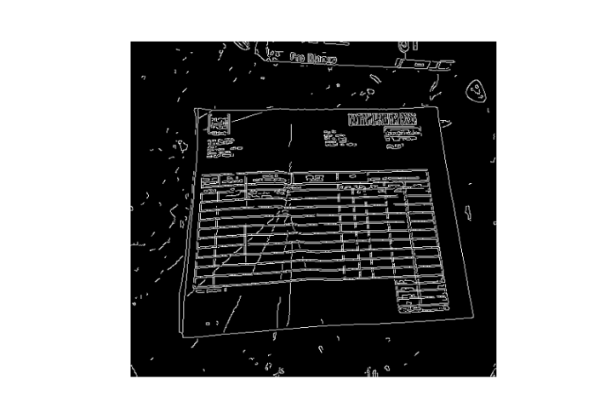
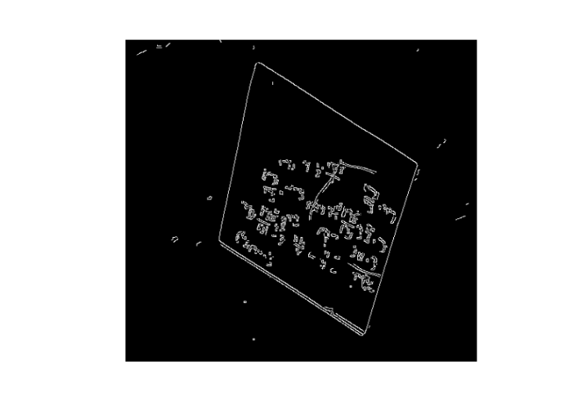
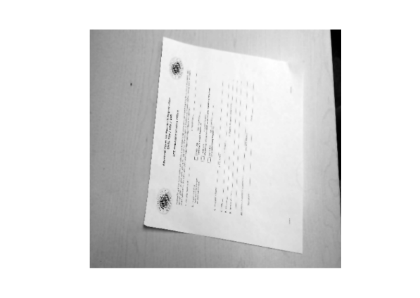

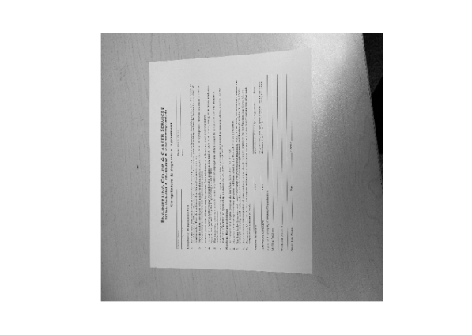

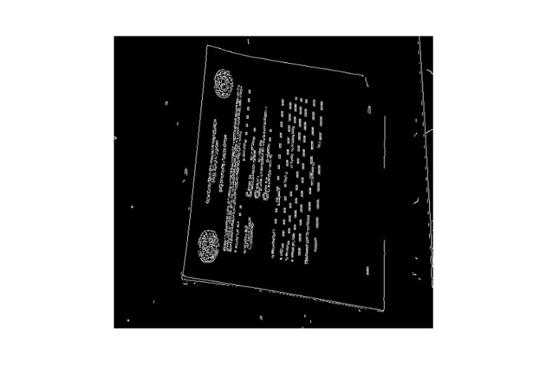
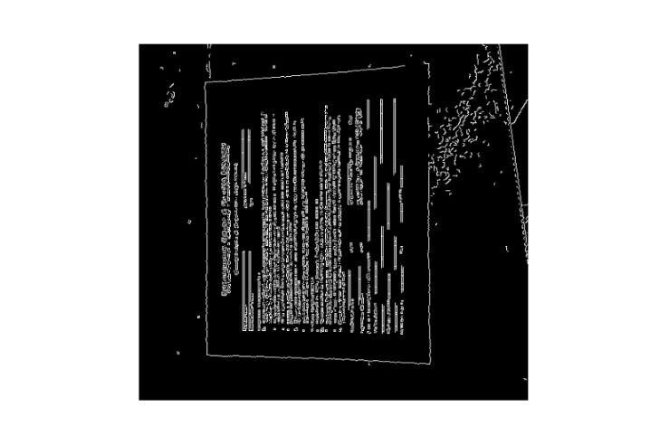
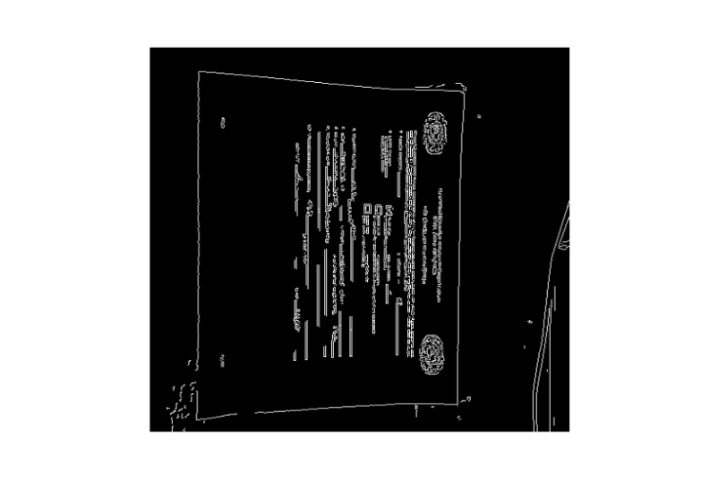
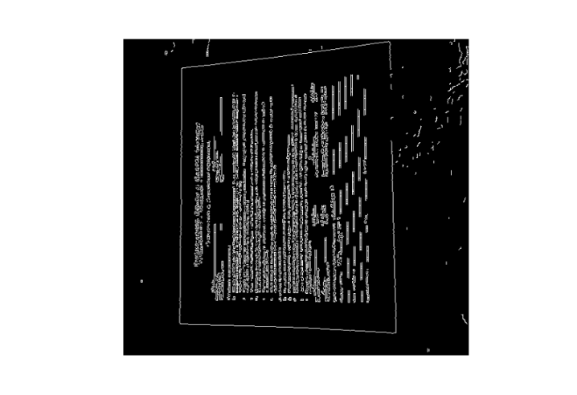
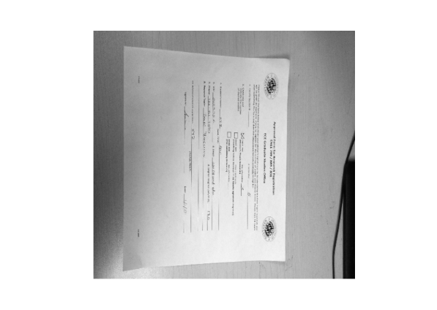

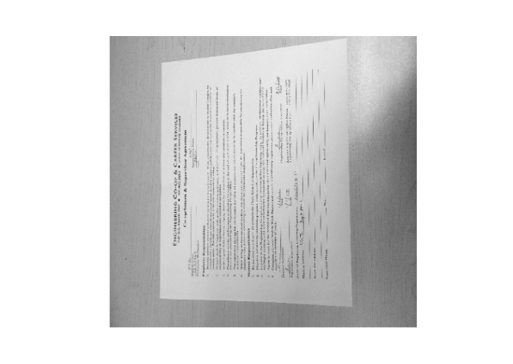

Preprocessing Results Left: Gray scale, resized and smoothened images Right: Canny edges with low threshold

Slide 6
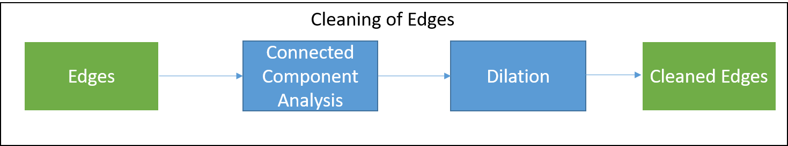
Cleaning edges

Slide 7
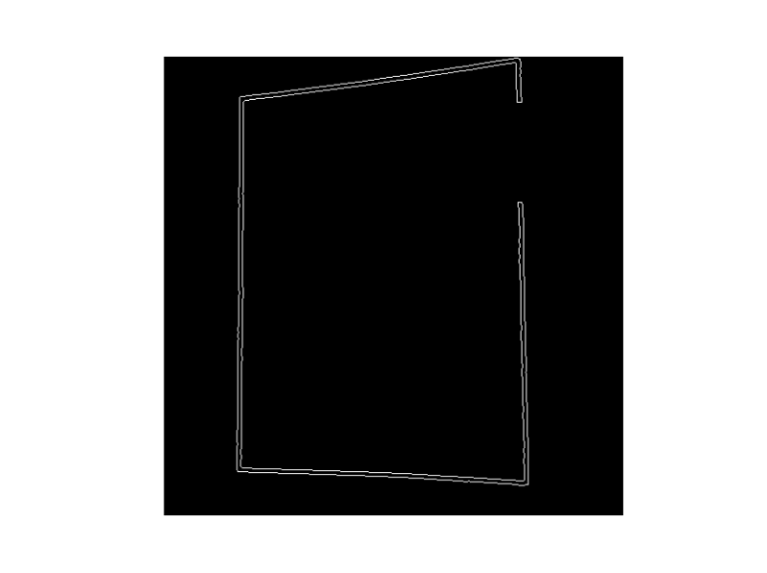
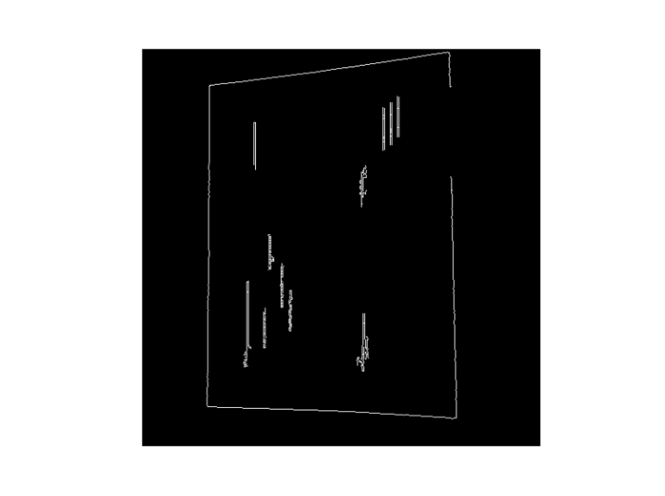
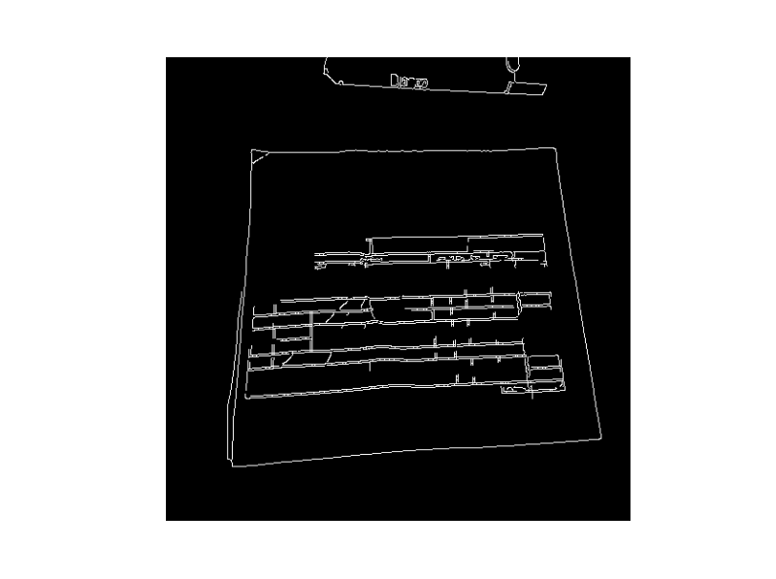
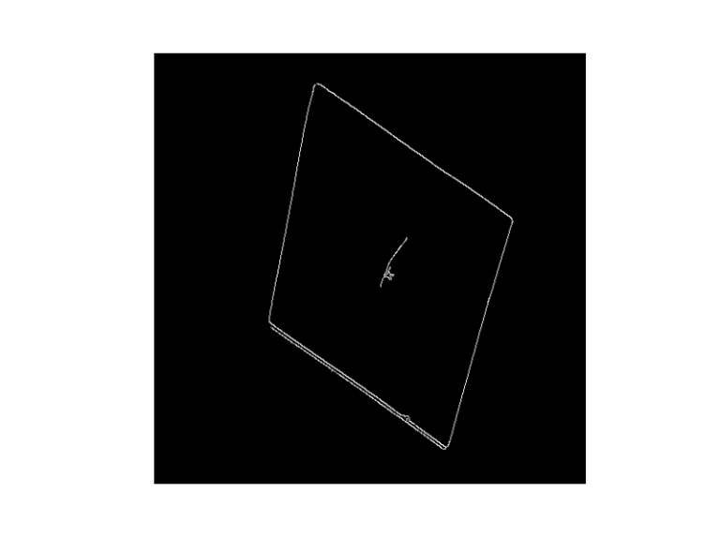
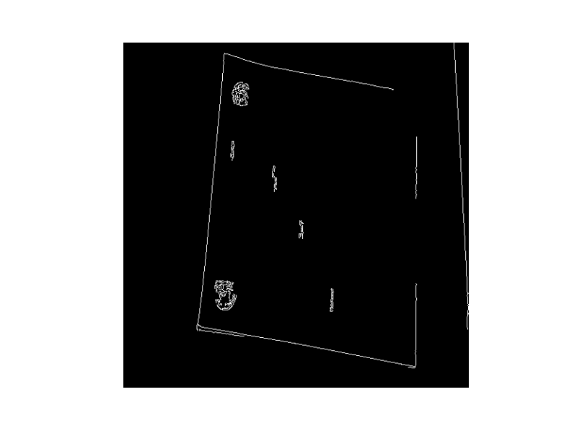
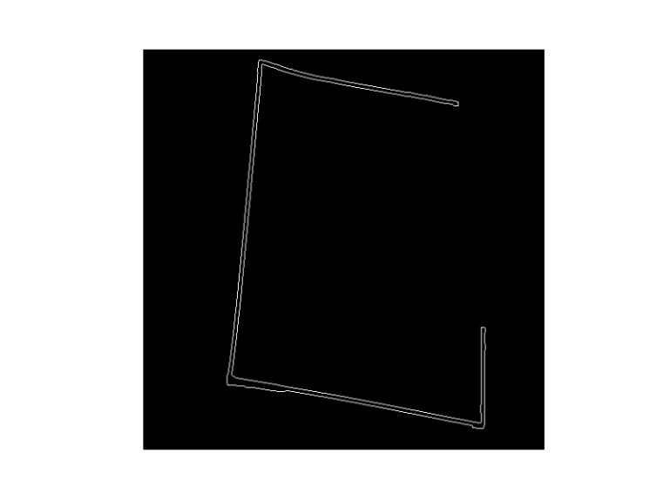
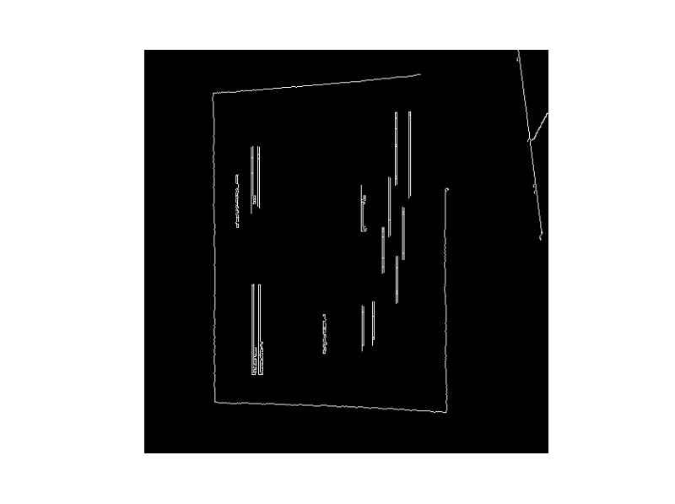
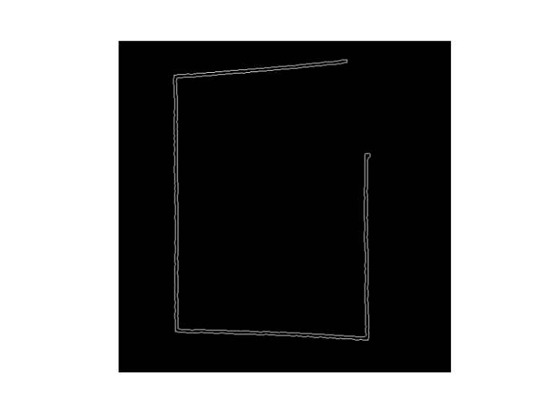
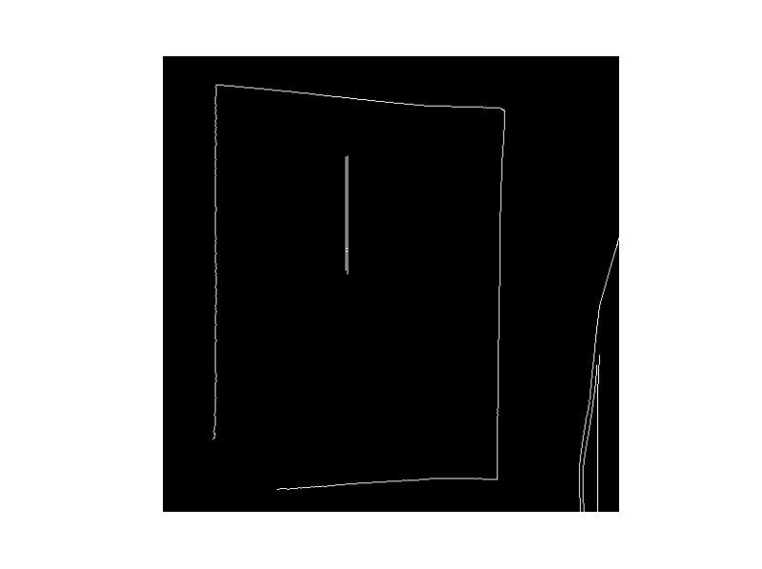
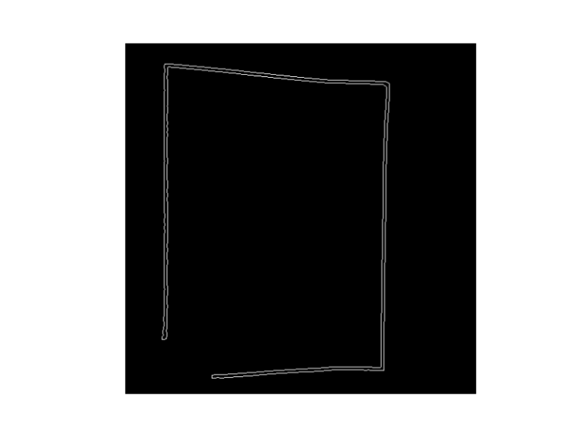
Edge Cleaning Results

Slide 8
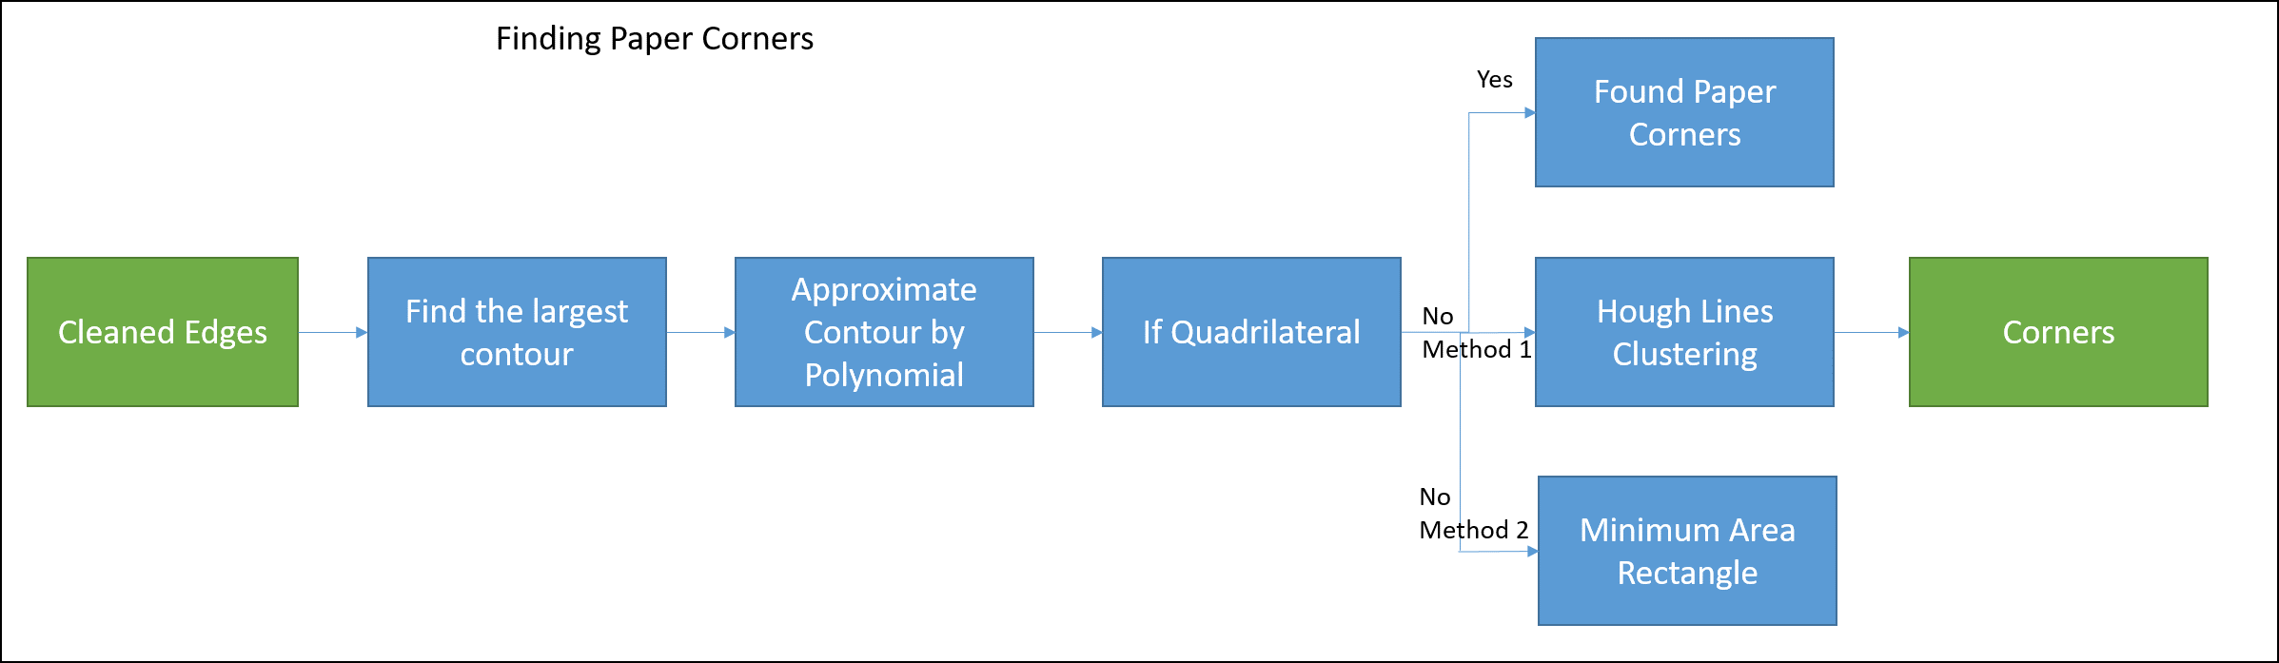
Corner Detection

Slide 9
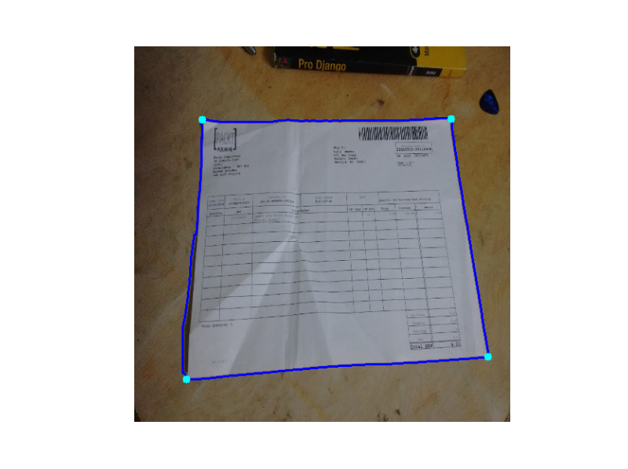
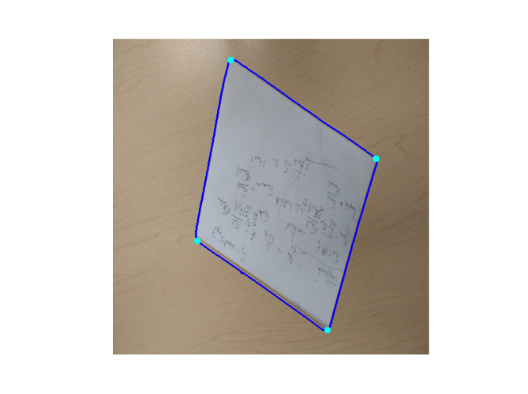
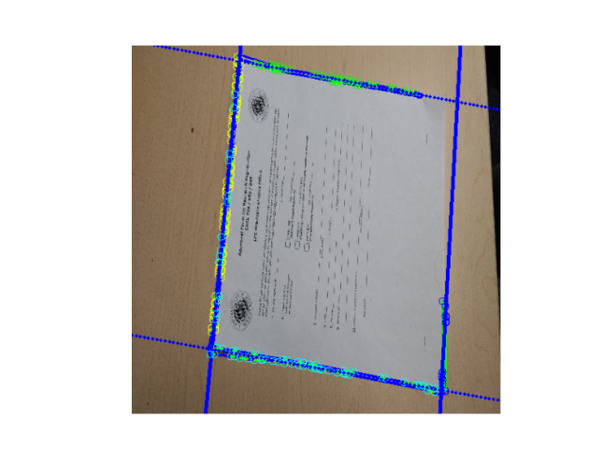

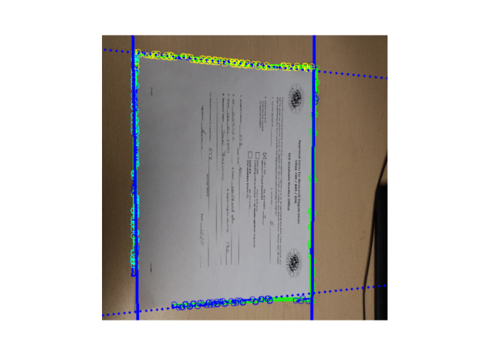

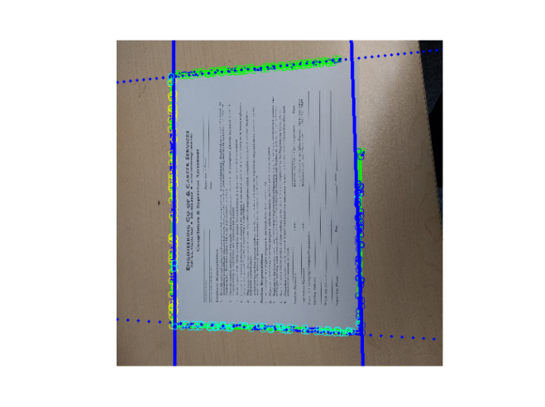

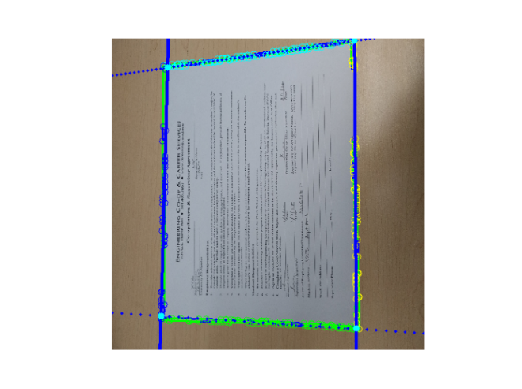

Corner Detection Results
Corners detected using approxPolydp function of openCV on the largest contour
Corners detected using Hough Line clustering technique

Slide 10
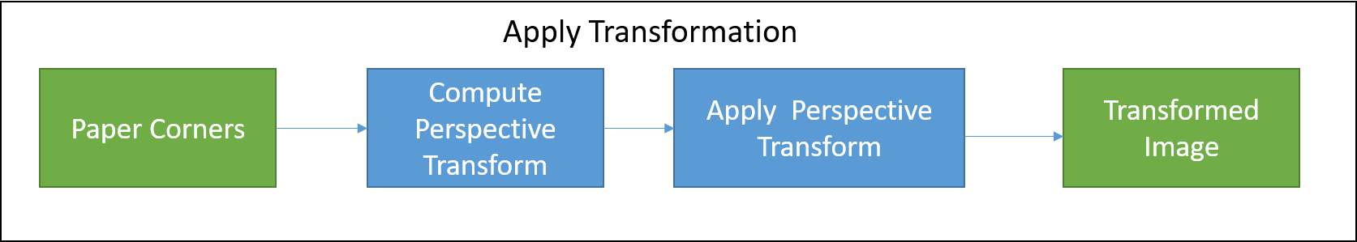
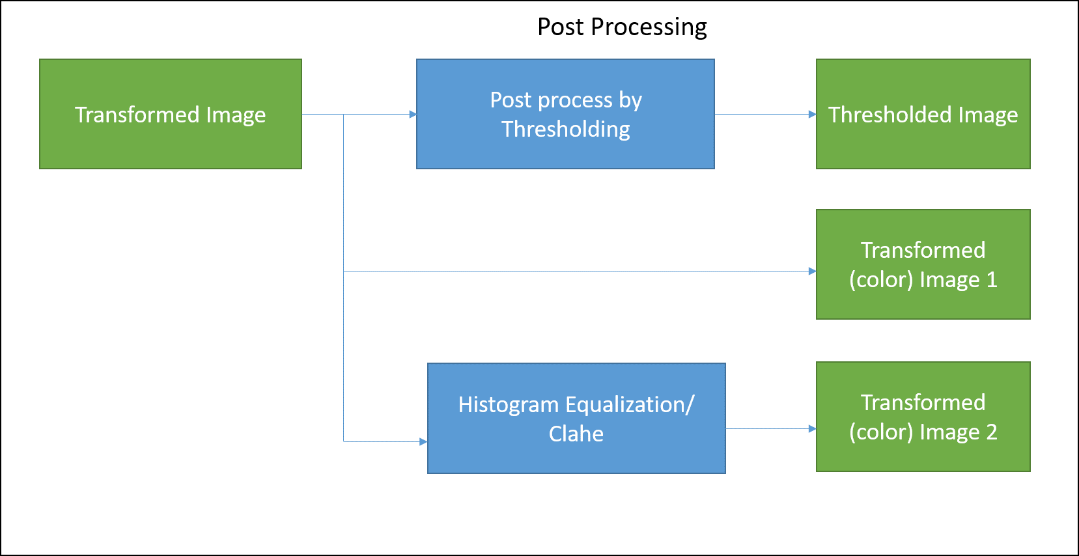
Transformation and Postprocessing

Slide 11
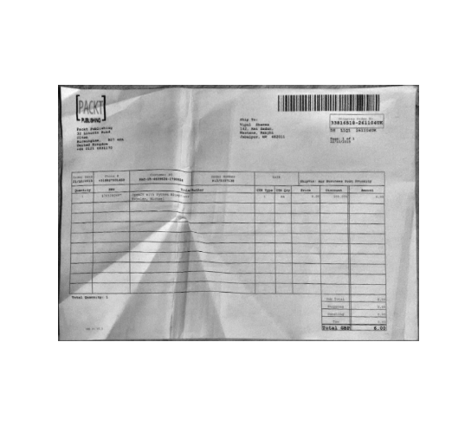
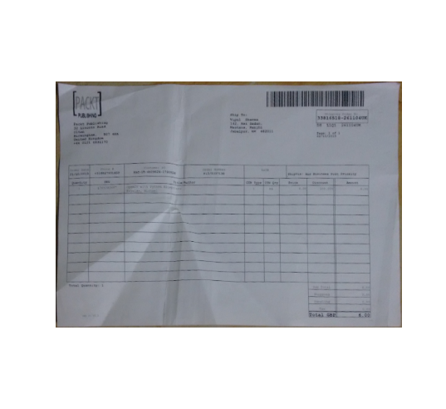
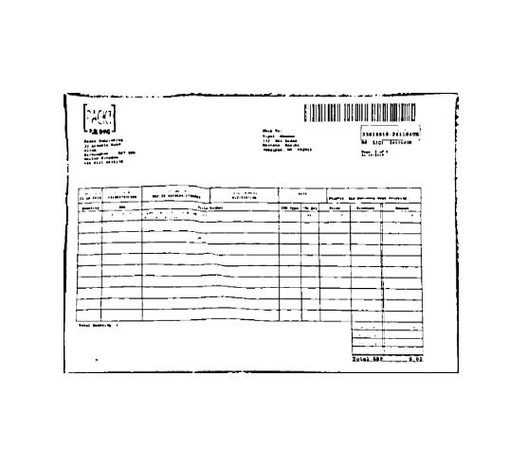
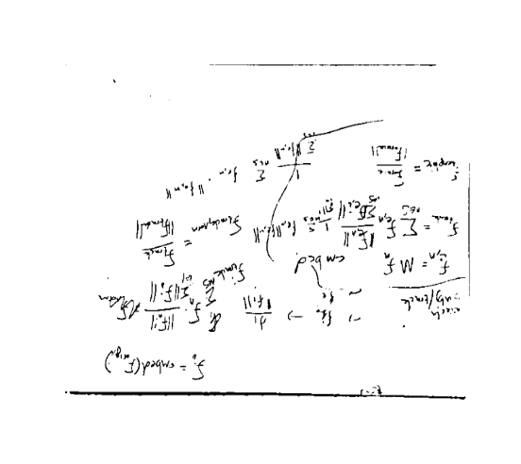
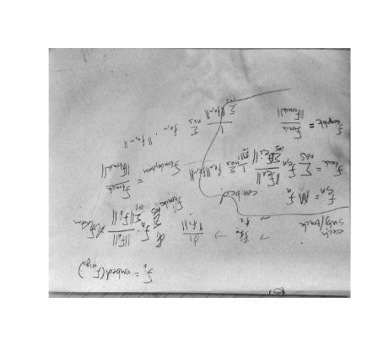
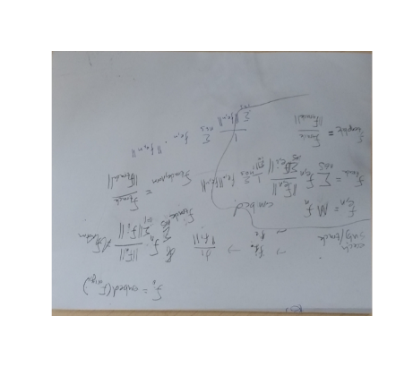
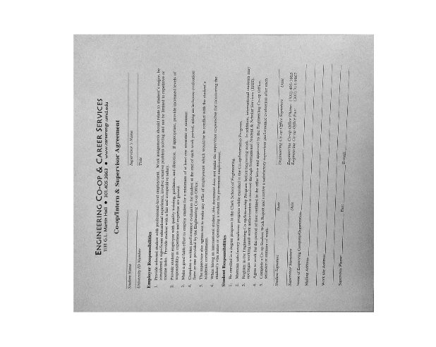
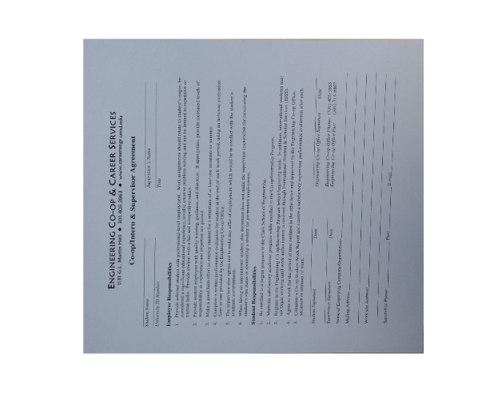
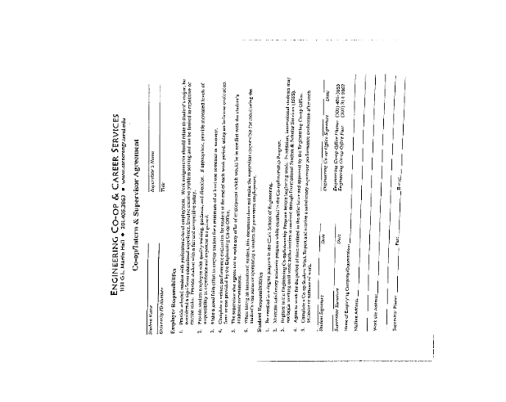
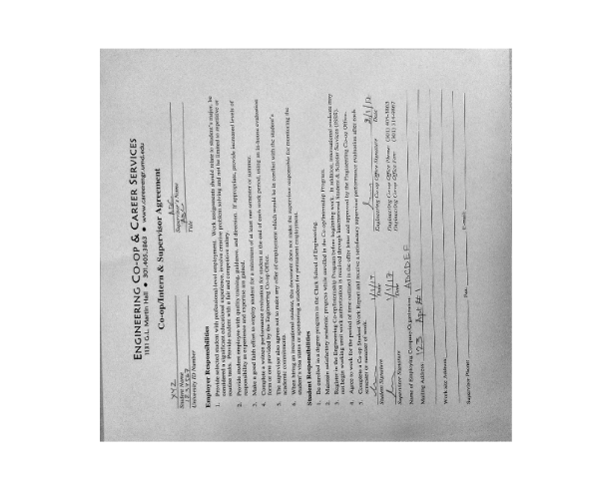
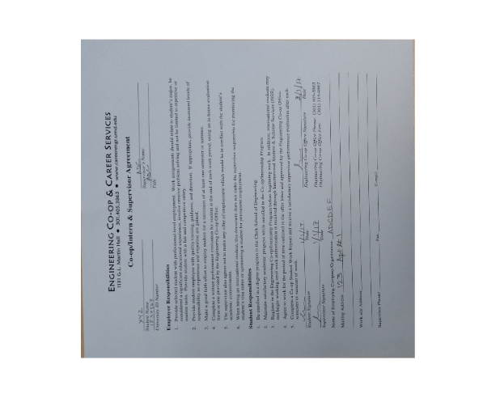
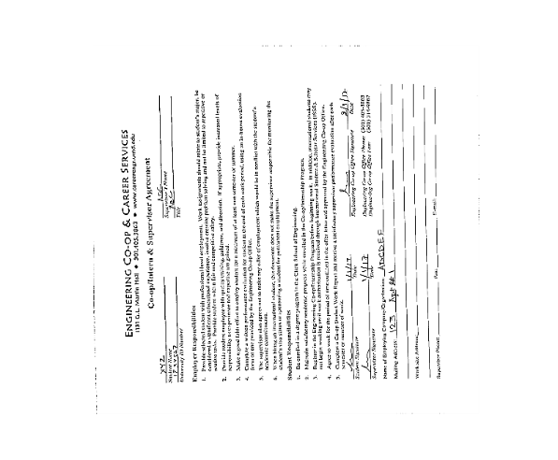
Apply Transform & Post Processing Results

Slide 12
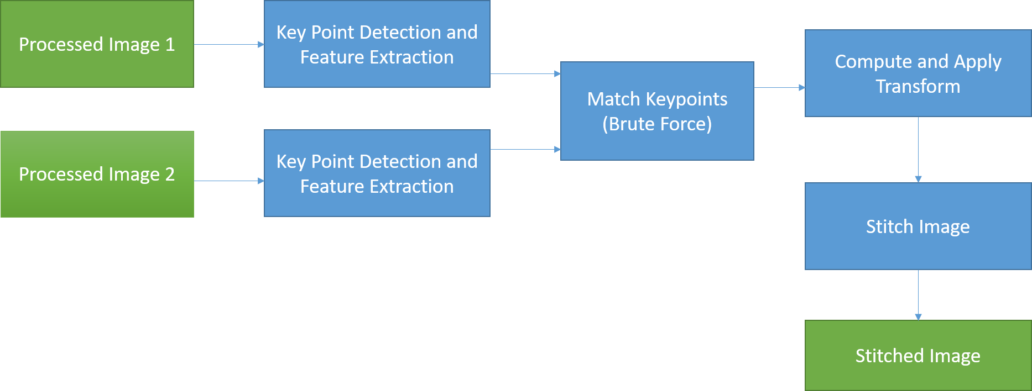
Partial form scanning and stitching

Slide 13
Partial form scanning
Determine edges of the stitched image
Clean the edges using appropriate mask and connected component analysis
Detect corners using Hough Line clustering or Minimum area rectangle
Apply Transformation and postprocessing

Slide 14
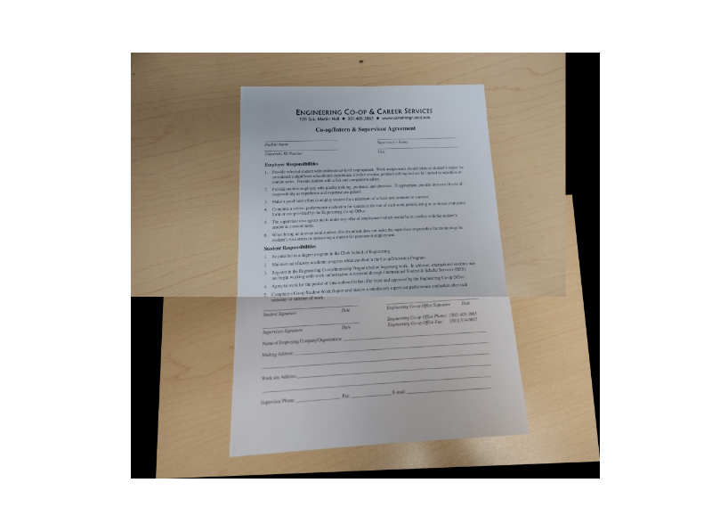
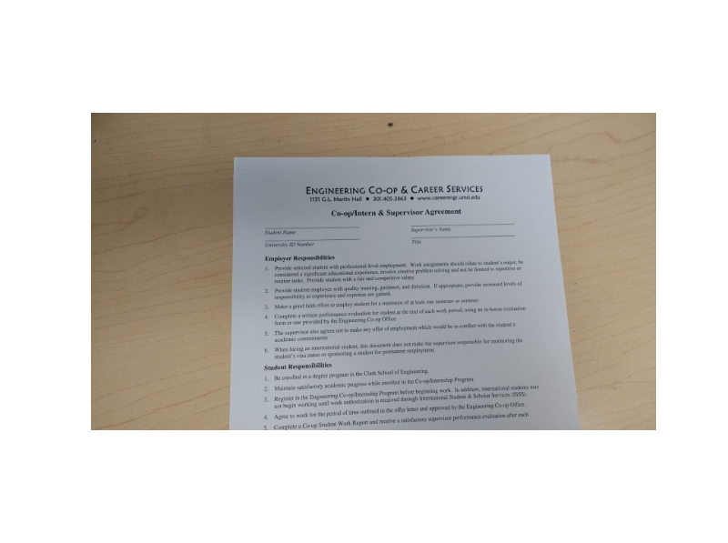
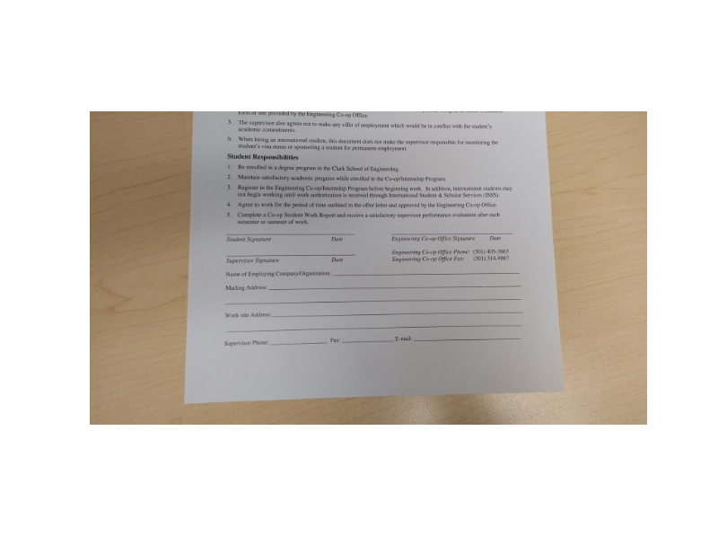

Partial form stitching Results

Slide 15




Partial form stitching Results

Slide 16












Partial form scanning Results
Edges in stitched form
Mask used for cleaning the edges
Cleaned edges
Contour of stitched image
Hough line clustering on stitched image
Scanned output: Histogram equalized, Clahe, Thresholded
Contour of stitched image

Slide 17
Reading filled forms
Normalized the input images (empty and filled form) using the basic scanning algorithm
Dilated the edges of the normalized images using a non square structuring element to join the characters together which gives us single connected component for each line
Analyzed the connected components to determine the minimum bounding rectangle
Classify the rectangles as text or non text regions
Match rectangles based on area and overlap criteria
Rectangles with no matches are region of interest
Assumption:
Text appears horizontally

Slide 18
Reading filled forms pipeline
Normalized Image 1
Edge Dilation
Connected Component Analysis
Classification of Text Non Text regions
OCR
Match Boxes
Area of Interest
No matches
Normalized Image 2
Edge Dilation
Connected Component Analysis
OCR
Classification of Text Non Text regions

Slide 19












Reading filled forms Results

Slide 20

Region of Interest

Slide 21


OCR Outputs
OCR output from the empty form
OCR output from the filled form

Slide 22





Sample Images Output

Slide 23
References
David G Lowe. Distinctive image features from scale-invariant keypoints. International journal of computer vision, 60(2):91–110, 2004.
R. Smith. An overview of the tesseract ocr engine. In Proceedings of the Ninth International Conference on Document Analysis and Recognition - Volume 02, ICDAR ’07, pages 629–633, Washington, DC, USA,2007. IEEE Computer Society
https://compvisionlab.wordpress.com/2013/05/13/image-blending-using-pyramid/
http://www.pyimagesearch.com/2016/11/07/intersection-over-union-iou-for-object-detection/

